Slide 1
Data Engineering Essentials: Build Real-World Data Pipeline with Python

Slide 2
About Me
🎓 Education:
B.Tech in Electronics and Communication Engineering (ECE) from Vellore Institute of Technology (2016-2020).
💼 Professional Journey:
Started my career at Capgemini as a Senior Analyst, progressing to the role of AWS Data Engineer. Led successful cloud migration projects for a Fortune 500 US-based insurance client, improving SLAs by 80%.
At Deloitte, specialized in orchestrating diverse marketing campaigns for a leading Indian private sector bank across multiple channels.
Currently part of Process Excellence Team (PET) at OPTUM, UnitedHealth Group ( a fortune 5 company)

Slide 3

About Me
🎓 Education:
B.Tech in Electronics and Communication Engineering (ECE) from Vellore Institute of Technology (2016-2020).
💼 Professional Journey:
Started my career at Capgemini as a Senior Analyst, progressing to the role of AWS Data Engineer. Led successful cloud migration projects for a Fortune 500 US-based insurance client, improving SLAs by 80%.
At Deloitte, specialized in orchestrating diverse marketing campaigns for a leading Indian private sector bank across multiple channels.
Currently part of Process Excellence Team (PET) at OPTUM, UnitedHealth Group ( a fortune 5 company)

Slide 4

About Me
🎓 Education:
B.Tech in Electronics and Communication Engineering (ECE) from Vellore Institute of Technology (2016-2020).
💼 Professional Journey:
Started my career at Capgemini as a Senior Analyst, progressing to the role of AWS Data Engineer. Led successful cloud migration projects for a Fortune 500 US-based insurance client, improving SLAs by 80%.
At Deloitte, specialized in orchestrating diverse marketing campaigns for a leading Indian private sector bank across multiple channels.
Currently part of Process Excellence Team (PET) at OPTUM, UnitedHealth Group ( a fortune 5 company)

Slide 5
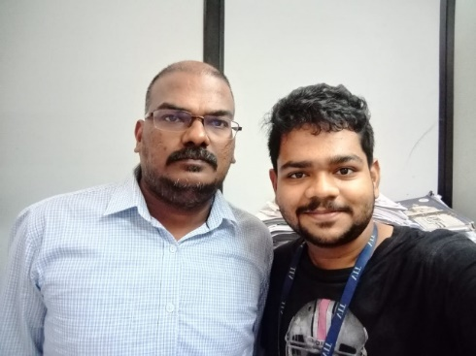
About Me
🎓 Education:
B.Tech in Electronics and Communication Engineering (ECE) from Vellore Institute of Technology (2016-2020).
💼 Professional Journey:
Started my career at Capgemini as a Senior Analyst, progressing to the role of AWS Data Engineer. Led successful cloud migration projects for a Fortune 500 US-based insurance client, improving SLAs by 80%.
At Deloitte, specialized in orchestrating diverse marketing campaigns for a leading Indian private sector bank across multiple channels.
Currently part of Process Excellence Team (PET) at OPTUM, UnitedHealth Group ( a fortune 5 company)

Slide 6
What is Data Engineering?

Slide 7
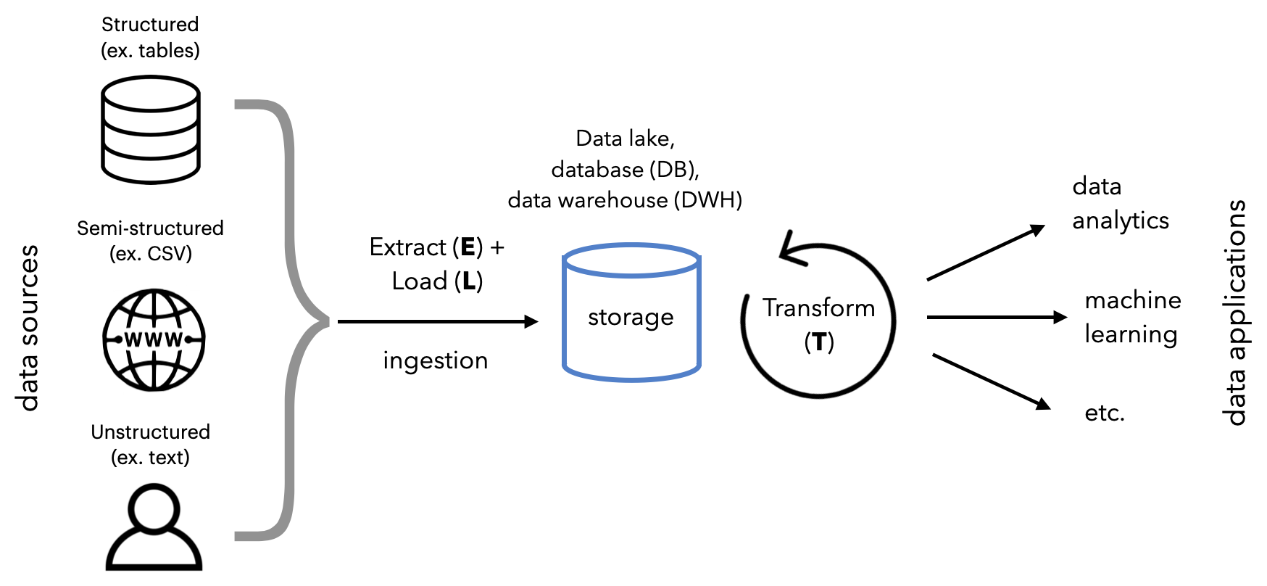
What is Data Engineering?
Definition: Data Engineering is the practice of designing and building systems for collecting, storing, and analyzing data at scale.

Slide 8
Why is Data Engineering Important?

Slide 9

Why is Data Engineering Important?
Enables organizations to make data-driven decisions

Slide 10
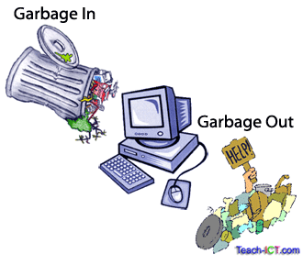
Why is Data Engineering Important?
Enables organizations to make data-driven decisions
Bridges the gap between raw data and actionable insights

Slide 11

Why is Data Engineering Important?
Enables organizations to make data-driven decisions
Bridges the gap between raw data and actionable insights
Powers analytics, machine learning, and reporting

Slide 12
Data Engineering Lifecycle

Slide 13
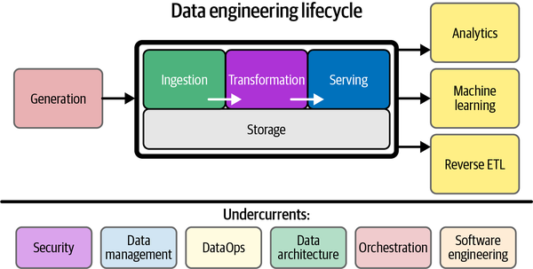
Data Engineering Lifecycle

Slide 14
Ingestion – Pulling Data from Different Sources

Slide 15
Ingestion – Pulling Data from Different Sources
Common Data Sources:
Databases (e.g., MySQL, PostgreSQL)

Slide 16
Ingestion – Pulling Data from Different Sources
Common Data Sources:
Databases (e.g., MySQL, PostgreSQL)
APIs

Slide 17
Ingestion – Pulling Data from Different Sources
Common Data Sources:
Databases (e.g., MySQL, PostgreSQL)
APIs
Files (CSV, JSON, Parquet)

Slide 18
Ingestion – Pulling Data from Different Sources
Common Data Sources:
Databases (e.g., MySQL, PostgreSQL)
APIs
Files (CSV, JSON, Parquet)
Streaming data (Kafka, Kinesis)

Slide 19
Data Engineering Lifecycle

Slide 20
Transformation – Transforming the raw data
Basic Data Transformations
Improve data quality by removing errors, filling gaps, and simplifying data.
Data Cleansing: Fix errors and map values. Example: Replace empty fields with 0; map “Parent” to “P” and “Child” to “C.”
Data Deduplication: Identify and remove duplicate records.
Data Format Revision: Standardize formats (e.g., convert units like kg to lbs in recipe databases).

Slide 21
Transformation – Transforming the raw data
Advanced Data Transformations
Use business rules to optimize data for analysis.
Derivation: Calculate new values. Example: Convert revenue to profit (Revenue - Expenses).
Joining: Link data from multiple sources. Example: Combine vendor prices to find total purchase cost.
Splitting: Divide attributes into multiple columns. Example: Split “Jane John Doe” into First, Middle, Last Name.
Summarization: Reduce datasets by aggregating values. Example: Summarize invoice values to calculate Customer Lifetime Value (CLV).

Slide 22
Data Engineering Lifecycle

Slide 23
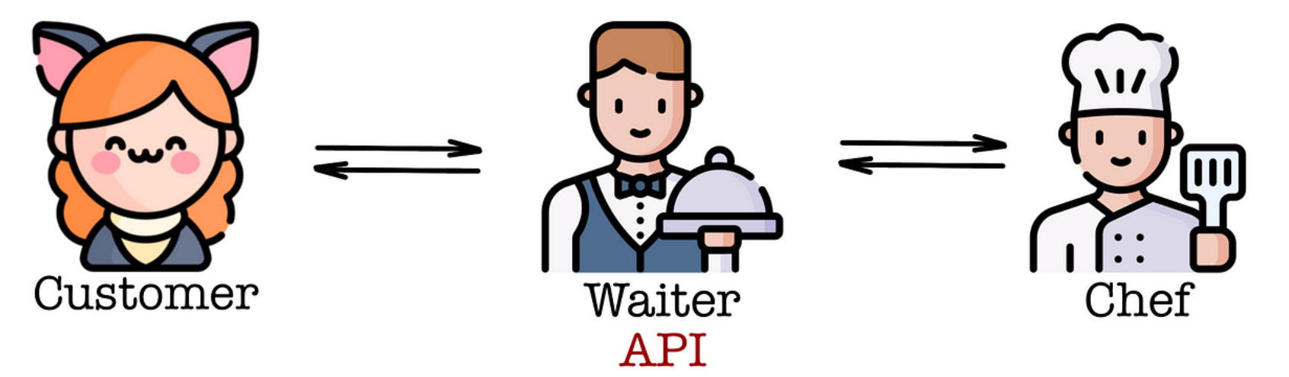
API – Application Programming Interface

Slide 24
Practical Example

Slide 25
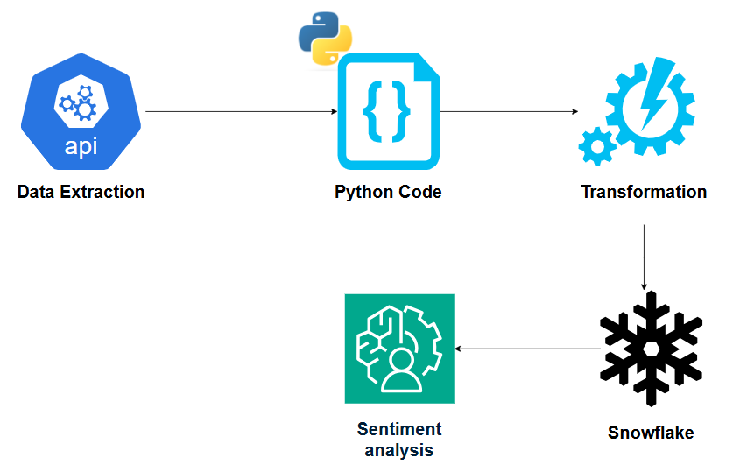
Sentiment Analysis of News

Slide 26
Q&A

